Slide 1
Microsoft Azure Infrastructure as a Service
Stu Fox
Technical Specialist, Microsoft Azure
April 2017
Notes:
This roadmap covers recent announcements and upcoming investments in the next 6 months

Slide 2
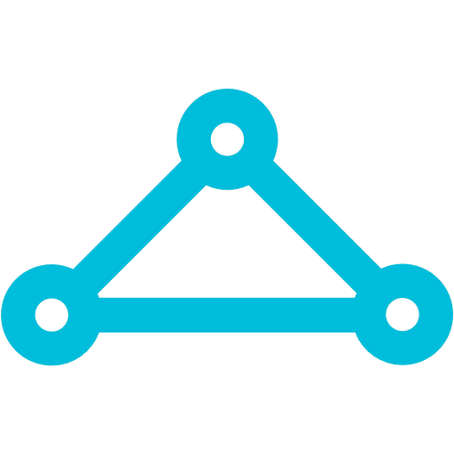


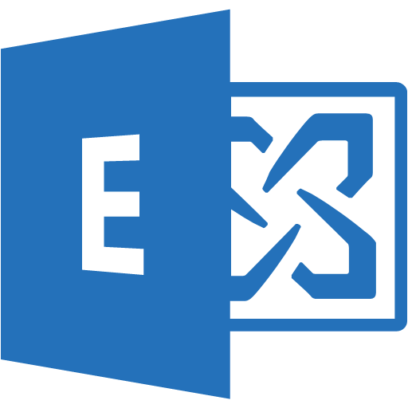
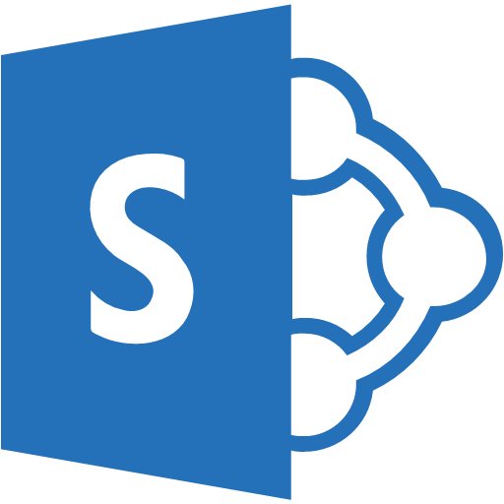










Networking
ExpressRoute
Exchange Provider or WAN Provider
Office 365 Services
Traffic to Office 365 Services and soon CRM Online
Traffic to public IP addresses in Azure
Scale-out SDN services (WAN, DDOS, Load Balancer, Virtual Networks, ACLs)
Main Corporate Site
Traffic to Virtual Networks
Partner Edge
Microsoft Edge
Customer’s connection
Load Balancing
Auto
Scaling
Web Site
Analytics
& Reporting
SQL
Azure
Private WAN
Corporate
Network
Azure Public Services
Site 2 .. N
… and many more
Network Security Groups
VPN GATEWAY
Load Balancing
Auto
Scaling
VMs
Database
Point-to-Site VPN
Public Internet
Azure Private Services
Remote Site
Backend Connectivity
ExpressRoute for private enterprise grade connectivity
VPN Gateways for secure site-to-site connectivity
Point-to-site for dev / test
Front-End Access
Dynamic/Reserved Public IP addresses
Direct VM access, ACLs for security
Load balancing
DNS services: hosting, traffic management
DDoS protection
Native Azure security
Network Isolation
Network Security Groups
User Defined Routing
Network Virtual Appliance
Virtual Network
“Bring Your Own Network”
Segment with subnets and security groups
Control traffic flow with User Defined Routes

Slide 3


Compute size options
>80,000 IOPs
Premium Storage
A
D
F
L
G
A
Av2
D
Dv2
Dv3
F
N
G
H
Ev3
Av2
Av2
Av2
Av2
Av2
Av2
HIGHEST VALUE
LARGEST SCALE-UP
UNDER NDA ONLY
Notes:
Key talking points:
There are several new instance sizes that will be introduced over the next 6 months.
Each of these instance sizes are designed for increased performance and flexibility with capabilities tailored to specific workloads: B, Dv3, Ev3, L & M Series.

Slide 4



Managed disks
Simplified management for performance and scale
Overview
Simplifies management to avoid capacity planning mistakes and easier to scale
Integrates directly with virtual machine scale sets
WHAT THE ADMINISTRATOR SEES
BEHIND THE SCENES
500 IOPS PER DISK
MANAGED DISK (2000 IOPS)
STORAGE ACCOUNT
UNDER NDA ONLY
Notes:
Key talking points:
Managed disks is a new feature that is cross cutting. You will see different aspects of it when we discuss security and flexibility improvements later in the presentation.
Managed disks simplifies scale by taking away the need for the administrator to know about service limits of storage accounts and ensure that IOPS and throughput capabilities are easy to understand.
Managed disks also integrate directly with virtual machine scale sets to automatically scale the front end compute and the backend storage.

Slide 5
Managed disks Simple scalability and high resiliency
AVAILABILITY SET
FAULT DOMAIN 0
FAULT DOMAIN 1
FAULT DOMAIN 2
Overview
Managed disks simplifies the experience for managing storage and capacity planning in virtual machines and increases resiliency by abstracting the underlying architecture from the user and minimizing mistakes
Managed disks honor fault domains within an availability set and will deploy disks into storage accounts in the same fault domain as the virtual machines for additional physical redundancy
STORAGE ACCOUNT
STORAGE ACCOUNT
STORAGE ACCOUNT
UNDER NDA ONLY
Storage Account 2
Notes:
Key talking points:
Today disk management is a fairly complex process. Users must understand service limits of storage accounts and directly manage page blobs in one or more storage accounts to ensure they have enough storage capacity and IOPs. Availability is also an issue as a storage account could potentially be a single point of failure.
Managed disks solves the availability problem by ensuring the disks are created on physically separate stamps of storage when provisioned with VMs in an availability set.

Slide 6
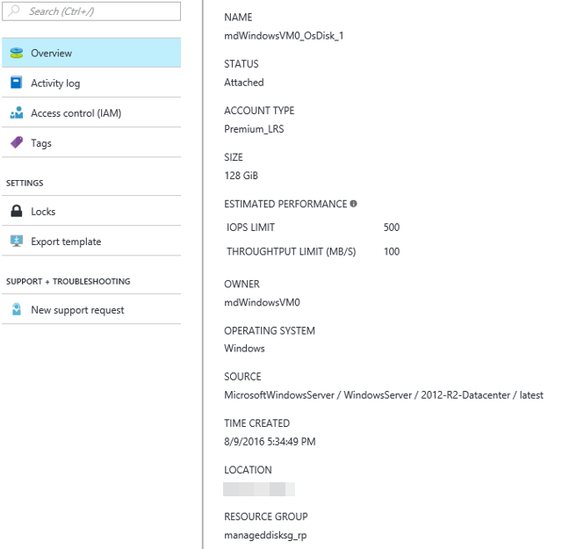
Managed disks Increased security through role-based access control
Overview
Managed disks do not allow direct access to the VHD but instead allow common operations through Azure. Managed disks are a top level entity which allows fine grained permission management through role based access control
Disks are managed by Azure (no direct access)
Disk level role based access control (RBAC)
UNDER NDA ONLY
Notes:
Key talking points:
Another key aspect of managed disks is the ability to control access to the disk through role based access control.
This is the same security mechanism Azure uses to grant access to other resources in Azure.
The underlying VHDs for managed disks are not exposed directly to users. This will mitigate the risk of users going behind the controls of RBAC and accessing via the storage account directly.

Slide 7

Single instance SLA on virtual machines Guaranteed service level availability with a single virtual machine
VIRTUAL NETWORK
Overview
Azure will guarantee availability at 99.9% with only a single instance!
Requires Premium Storage
AVAILABILITY SET – 99.95% SLA
SINGLE VM – 99.95% SLA
UNDER NDA ONLY
Notes:
Key talking points:
Today for all Internet facing Virtual Machines that have two or more instances deployed in the same Availability Set, we guarantee you will have external connectivity at least 99.9% of the time.
Azure will offer a service level agreement for a single virtual machine when the virtual machine is deployed with SSD backed premium storage.

Slide 8
Accelerated networking Increased network performance
Overview
Direct communication with the network interface card using Single Root IO Virtualization (SR-IOV) in Supported VMs
Significantly Reduced Latency
Reduced Jitter
Run the most performance-sensitive workloads
25 Gbps networking speed
UNDER NDA ONLY
Notes:
Key talking points:
Allows users to enable Single Root IO Virtualization (SR-IOV) in supported Azure Virtual Machines (VM) and run their most performance-sensitive workloads in the cloud. This technology allows a VM to communicate directly through the Network Interface Card (NIC) using SR-IOV, bypassing the Virtual Switch (vSwitch) and host completely. This results in a reduction of latency by orders of magnitude from ~300 to ~30 microseconds as well as reduced jitter, allowing VMs to achieve higher packets per second (PPS) than ever before.

Slide 9

Network watcher and diagnostics Understand your network and resolve problems
SOFTWARE DEFINED NETWORKING
LOG EMITTING
VIRTUAL NETWORK
LOAD BALANCER
EXPRESS
ROUTE
DNS
TRAFFIC MANAGER
VPN GATEWAY
APPLICATION GATEWAY
Overview
Visualize IP Flow for enhanced troubleshooting
Integration with Operations Management Suite (OMS)
VPN Gateway and Tunnel Health
Application Gateway Metrics
Network Security Groups and User Defined Routes Diagnostics improvements
DOWNLOAD
ANALYZE
LOG STORAGE AND ARCHIVING
BLOB STORAGE
MICROSOFT ANALYTICS
Operations
Management Suite
HDInsight
Power BI
Machine
Learning
THIRD PARTY OR ON-PREM TOOLS
LOG ANALYSIS AND INSIGHTS
UNDER NDA ONLY
Notes:
https://azure.microsoft.com/en-us/blog/announcing-azure-network-watcher-network-performance-monitoring-and-diagnostics-service-for-azure/
Key talking points:
Improved diagnostics and the Network Watcher service will enable monitoring and diagnostics at the network level for virtual machines.
These capabilities spread across the spectrum of resource health monitoring, metrics and alerting, diagnostic APIs, a new network monitoring service. Everything geared towards providing you the ability to monitor and diagnose your network infrastructure in Azure.
VPN Gateway and Tunnel Health
We are announcing the addition of Virtual Private Network (VPN) Gateway and VPN Tunnel resource health, this will provide you real time health information about these resources to gain actionable information on health and outages related to your resource.
Application Gateway Metrics
We are announcing server performance metrics for Application Gateway, this metric will provide you an aggregated view of the health of your gateway hosts. Enabling you to get a single unified view with total request count, average latency, total failed request count, total throughput, min of unhealthy and healthy host count.
NSG and UDR Diagnostics
We are also glad to announce improvements to Network Security Group (NSG) and User-Defined Routes (UDR) diagnostics, to troubleshoot network traffic flows on your Virtual Machine (VM)/Network Interface Card (NIC). You can now view all the effective security rules impacting a given VM/NIC, irrespective of whether the NSGs are applied at NIC and/or Subnet. You can also view the full list of effective routes, including system routes, impacting given NIC traffic. All of these APIs will be available in Azure Resource Manager (ARM) and can be managed via REST APIs, .NET SDK, PowerShell cmdlets, command-line interface and Azure portal. Learn more about NSG and UDR diagnostics. Learn more about NSG and UDR Diagnostics .
Network Watcher
We are also pleased to announce Network Watcher, a service that will enable you to monitor and diagnose conditions at a network scenario level, besides the above mentioned resource level monitoring and diagnostics capabilities. Network diagnostic and visualization tools available with Network Watcher will enable you to take packet captures on a Virtual Machine (VM), help you understand if an IP flow is allowed or denied on your VM, find where your packet will be routed from a VM and gain insights to your network topology.
Packet capture capability available to you in Network Watcher will help you diagnose network fault conditions, to monitor your network for security and compliance needs. You will be able fine tune your packet captures by specifying the protocol (TCP, UDP or both), IP address and port ranges, size of capture and storage location to save the capture. Packet captures are stored in a standard PCAP file format to facilitate usage of third party tools to analyze the output. You can store these captures either on the attached VM disk or specify your own blob storage location.
Network watcher comes with a tight integration with existing Azure services like OMS. You can now configure OMS hub as one of the destination for storing metric and logs, this will enable you to utilize the existing capabilities of OMS to do analyze and present your metrics and logs.

Slide 10
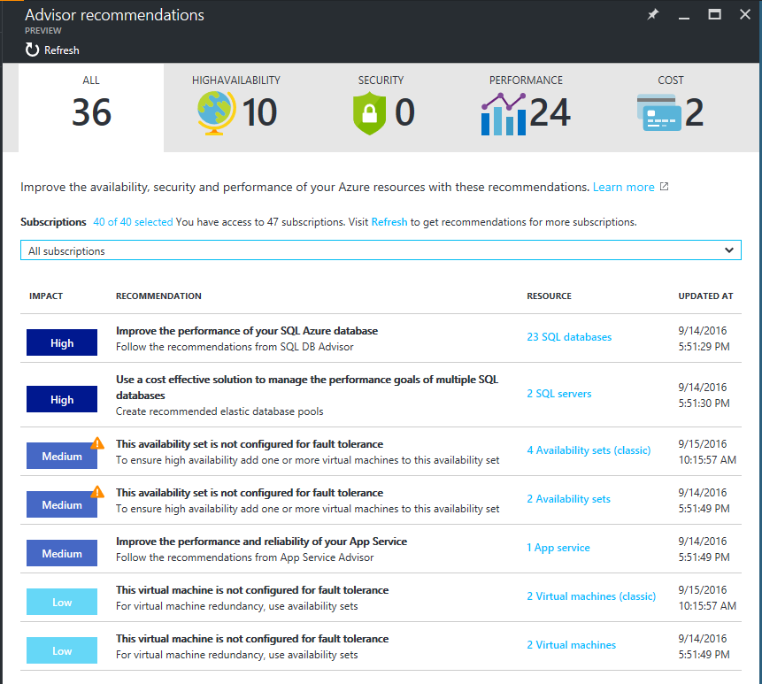
Azure Advisor
GA
Released
Mar ‘17
Personalized Cloud Consultant.
Actionable recommendations to improve resource availability, security, performance, and cost
Implement fixes quickly from inline recommendations.
https://azure.microsoft.com/en-us/services/advisor/

Slide 11
Skills for the Azure IT Pro
PowerShell
Infrastructure as Code
Azure Resource Manager
Visual Studio Team Services
Linux!

Slide 12
Readiness
Microsoft Virtual Academy https://www.microsoftvirtualacademy.com
MOOC https://openedx.Microsoft.com/courses
Azure Skills Initiative https://azure.microsoft.com/en-us/learn/skills/
http://aka.ms/azposterapp
https://azure.microsoft.com/en-us/updates/

Slide 13
The labs
If you’re new to Azure – do Azure IAAS 101
If you’ve got experience, 3 options
Building a resilient IAAS architecture
Enterprise Ready Cloud
Enterprise Networking

Slide 14
Massively Open Online Courses (MOOCs)
Free and easily accessible
Build and demonstrate your capability
Learn on your own time
Apply and validate your skills
Fundamentals | Nov 22 | Microsoft Azure Fundamentals |  | Microsoft Azure for AWS Experts
Core IaaS | Nov 22 | Microsoft Azure Virtual Machines | Microsoft Azure Networks | Microsoft Azure Identity | Microsoft Azure Storage
Deployment | Dec 15 | Microsoft Azure App Services
 | Dec 31 | Databases in Microsoft Azure
Securing & Managing | Dec 15 | Managing Microsoft Azure Workloads
 | Dec 31 | Security and Compliance in Microsoft Azure
Scale and Agility | Dec 15 | Microsoft Azure Automation
 | Dec 31 | Microsoft Azure Deployment and Management
Migration | Mar 31 | Microsoft Azure IaaS Migration
DevOps | Q3 | Multiple courses
Notes:
Review the slide

